Slide 1


Task 2
Predicting customer buying behaviour
By
Miraj Ahmed
Data Science Virtual Internship

Slide 2
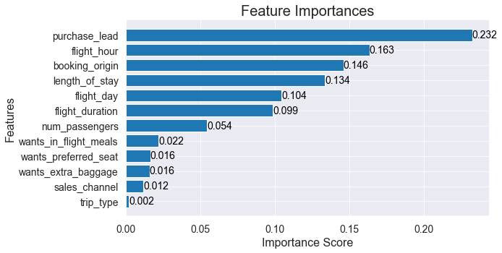
Using Random Forest Classifier with default hyperparameters. we received:
Accuracy 84.68%
AUC Score 0.7435
TOP 5 FEATURES THAT IMPACTS THE CUSTOMER'S BUYING BEHAVIOR ARE-
purchase_lead
flight_hour
booking_origin
length_of_stay
flight_day

